Slide 1
Advanced Exponential Smoothing

Slide 2
Advanced exponential smoothing
The advanced exponential smoothing techniques can be used when our time series has trend and/or seasonality.

Slide 3
Additive Trend

Slide 4
Holt’s model – additive trend
If our time series presents a trend component only, we can make forecasts using the double exponential smoothing, also called Holt’s linear trend model.
Holt’s model does not assume the trend to be constant – on the contrary, it can change over time.

Slide 5
Holt’s model – additive trend
This model employs two components: level and trend.
For each component, a smoothing parameter is used: α and β, respectively.

Slide 6
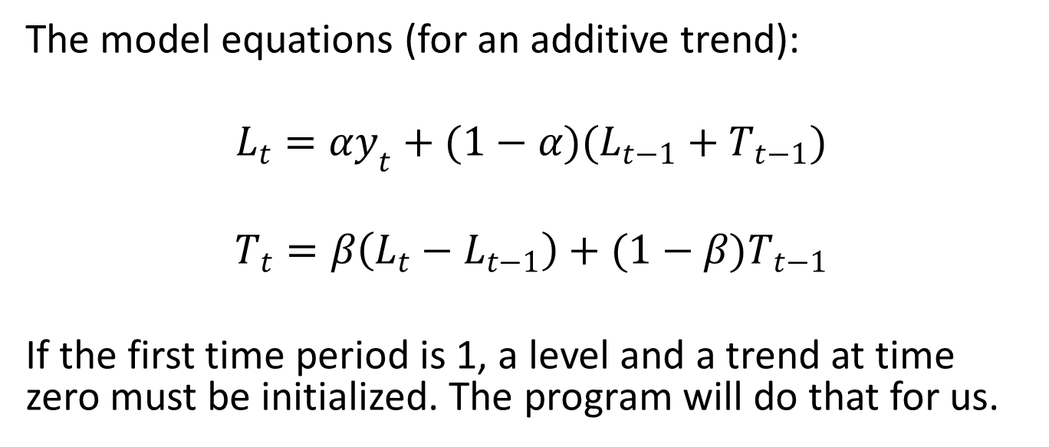
Holt’s model – additive trend
The model equations (for an additive trend):
$$L_{t}=αy_{t}+(1−α)(L_{t−1}+T_{t−1})$$
$$T_{t}=β\left(L_{t}−L_{t−1}\right)+(1−β)T_{t−1}$$
If the first time period is 1, a level and a trend at time zero must be initialized. The program will do that for us.

Slide 7
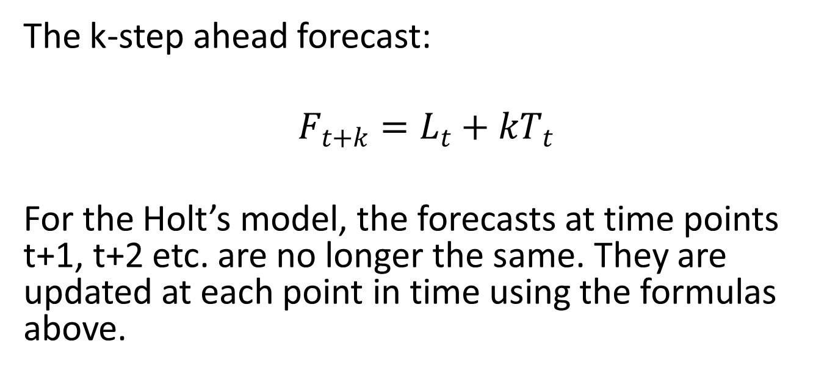
Holt’s model – additive trend
The k-step ahead forecast:
$$F_{t+k}=L_{t}+kT_{t}$$
For the Holt’s model, the forecasts at time points t+1, t+2 etc. are no longer the same. They are updated at each point in time using the formulas above.

Slide 8
Holt’s model – additive trend
The k-step ahead forecast:
$$F_{t+k}=L_{t}+kT_{t}$$
For the Holt’s model, the forecasts at time points t+1, t+2 etc. are no longer the same. They are updated at each point in time using the formulas above.

Slide 9
Holt’s model – additive trend
If we assume an additive error (so errors have a constant size), the forecasts are given by this formula:
F_{t+k} = L_{t} + T_{t} + e_{t}

Slide 10
Holt’s model – additive trend
In the case of multiplicative error the forecast formula will be:
F_{t+k} = (L_{t} + T_{t}) x (1 + e_{t})

Slide 11
Multiplicative Trend

Slide 12
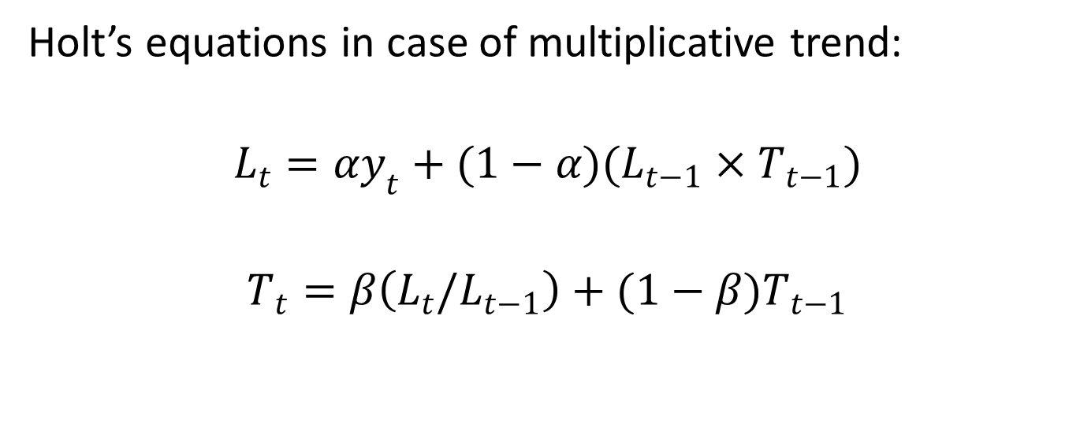
Holt’s model – multiplicative trend
Holt’s equations in case of multiplicative trend:
$$L_{t}=αy_{t}+(1−α)(L_{t−1}×T_{t−1})$$
$$T_{t}=β\left(L_{t}/L_{t−1}\right)+(1−β)T_{t−1}$$

Slide 13
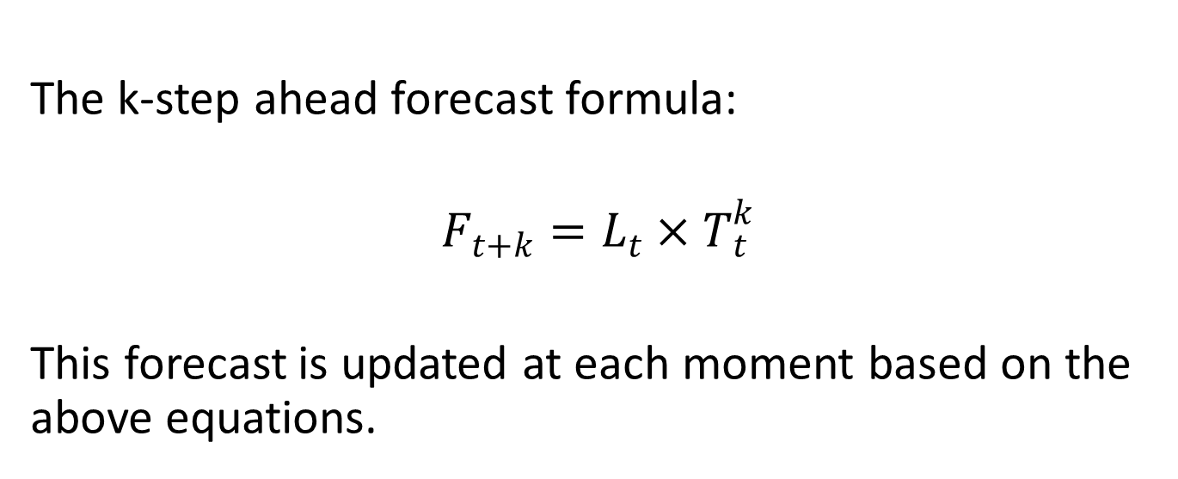
Holt’s model – multiplicative trend
The k-step ahead forecast formula:
$$F_{t+k}=L_{t}×T_{t}^{k}$$
This forecast is updated at each moment based on the above equations.

Slide 14
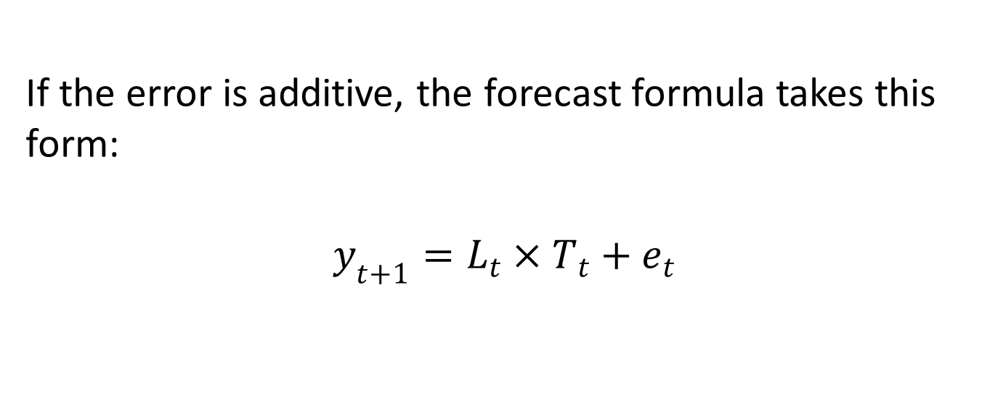
Holt’s model – multiplicative trend
If the error is additive, the forecast formula takes this form:
$$y_{t+1}=L_{t}×T_{t}+e_{t}$$

Slide 15
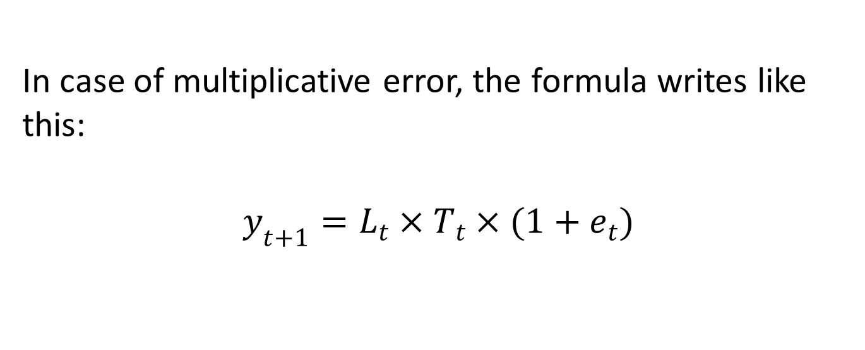
Holt’s model – multiplicative trend
In case of multiplicative error, the formula writes like this:
$$y_{t+1}=L_{t}×T_{t}×(1+e_{t})$$

Slide 16
Trend and Seasonality

Slide 17
Holt-Winter’s model
If our time series presents both trend and seasonality, we must use an advanced exponential smoothing model with three smoothing constants, corresponding to level, trend and seasonality, respectively.
These smoothing factors are denoted with α, β and γ.

Slide 18
Holt-Winter’s model
The Holt-Winter’s equations can be written in different ways, depending on the trend and seasonality type (addtive or multiplicative).
We will only write two sets of equations, as examples.

Slide 19
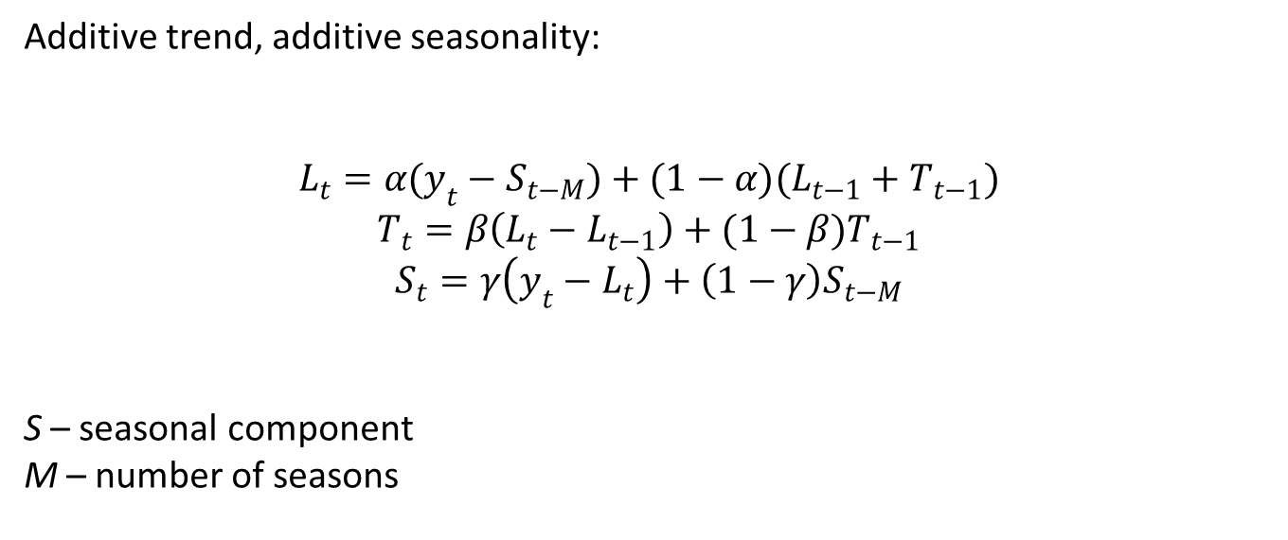
Holt-Winter’s model
Additive trend, additive seasonality:
$$L_{t}=α(y_{t}−S_{t−M})+(1−α)(L_{t−1}+T_{t−1})$$
$$T_{t}=β\left(L_{t}−L_{t−1}\right)+(1−β)T_{t−1}$$
$$S_{t}=γ\left(y_{t}−L_{t}\right)+\left(1−γ\right)S_{t−M}$$
S – seasonal component
M – number of seasons

Slide 20
Holt-Winter’s model
The forecasting equation:
F_{t+k} = L_{t} + kT_{t} + S_{t+k-M}

Slide 21
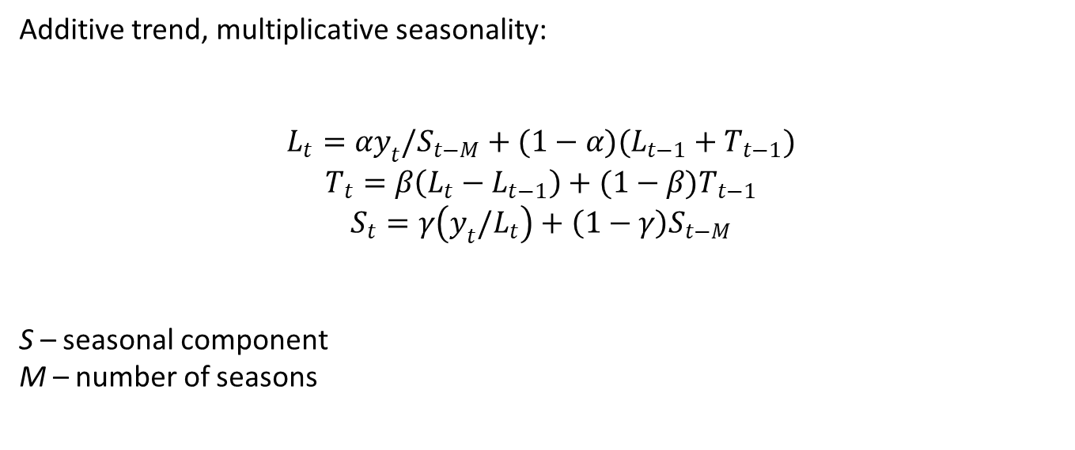
Holt-Winter’s model
Additive trend, multiplicative seasonality:
$$L_{t}=αy_{t}/S_{t−M}+(1−α)(L_{t−1}+T_{t−1})$$
$$T_{t}=β\left(L_{t}−L_{t−1}\right)+(1−β)T_{t−1}$$
$$S_{t}=γ\left(y_{t}/L_{t}\right)+\left(1−γ\right)S_{t−M}$$
S – seasonal component
M – number of seasons

Slide 22
Holt-Winter’s model
The forecasting equation:
F_{t+k} = (L_{t} + kT_{t})S_{t+k-M}

Slide 23
Holt-Winter’s model
Like in Holt’s model, the forecasts at time points t+1, t+2 etc. are not identical. They are updated at each point in time using the formulas above.

Slide 24
Holt-Winter’s model
To fit a Holt-Winter’s model we are going to use one of these methods in the ets() function:
MAA – multiplicative error, additive trend, additive seasonality
MMA – multiplicative error, multiplicative trend, additive seasonality
MAM - multiplicative error, additive trend, multiplicative seasonality
MMM – multiplicative error, multiplicative trend, multiplicative seasonality

Slide 25
Holt-Winter’s model
We could also consider a damped trend (a trend that flattens over time). In this case, we use “Ad” or “Md” as the second option in the “method” argument.

